Slide 1
DSC 80 Discussion #2
Hypothesis Testing
Permutation Tests

Slide 2
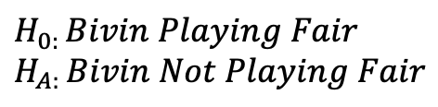
THE LOTTERY!
$$H_{0: }Bivin Playing Fair$$
$$H_{A: }Bivin Not Playing Fair$$
Assumption:
Bivin is playing fair.
Evidence:
Bivin won the lottery 10 times … in a row!
Probability:
The probably is very very very very very …. Very very small that I would win the lotter 10 times in a row.
IF
I am playing fair.
Decision:
Reject Ho: Bivin is playing fair.
Conclusion:
There is overwhelming evidence to suggest that Bivin is not playing fair.

Slide 3
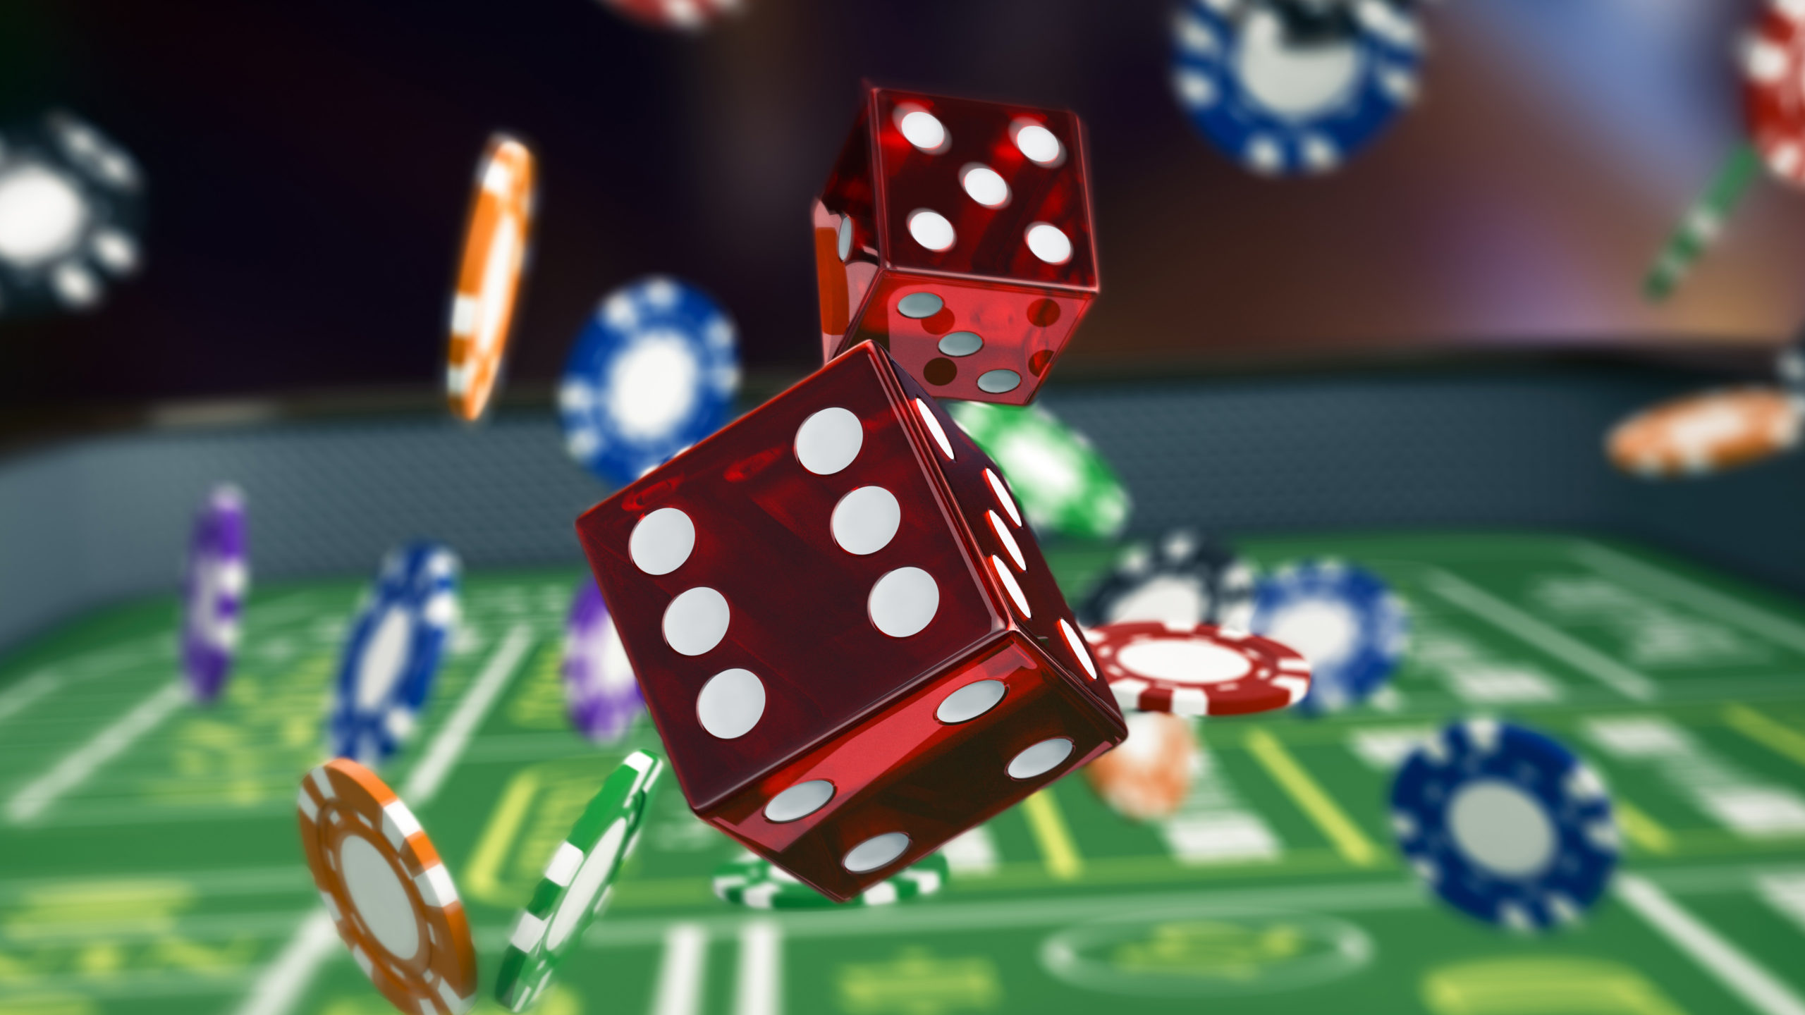

Slide 4
Break Out!
Test if a given die is fair!

Slide 5
Strategy: You run an experiment and roll a 6-sided die 120 times, record the counts of each face
🎲 Example: Testing If a Die Is Fair 🎲
Scenario: You want to test if a 6-sided dice is fair.
Thought: What does this mean mathematically?
[5, 28, 25, 20, 22, 20]

Slide 6
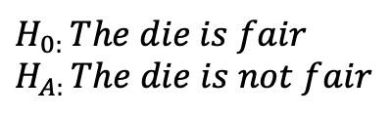
Fair Die?
Assumption:
The die is fair. Each probability is 1/6.
Evidence:
Count the proportion of each number that comes up in 120 tries.
Probability:
Calculate the proportion that each face came up in the 120 trials. Use TVD and simulations to see how rare this would be if
IF
the die were fair.
Decision:
Conclusion:
$$H_{0: }The die is fair$$
$$H_{A: }The die is not fair$$

Slide 7
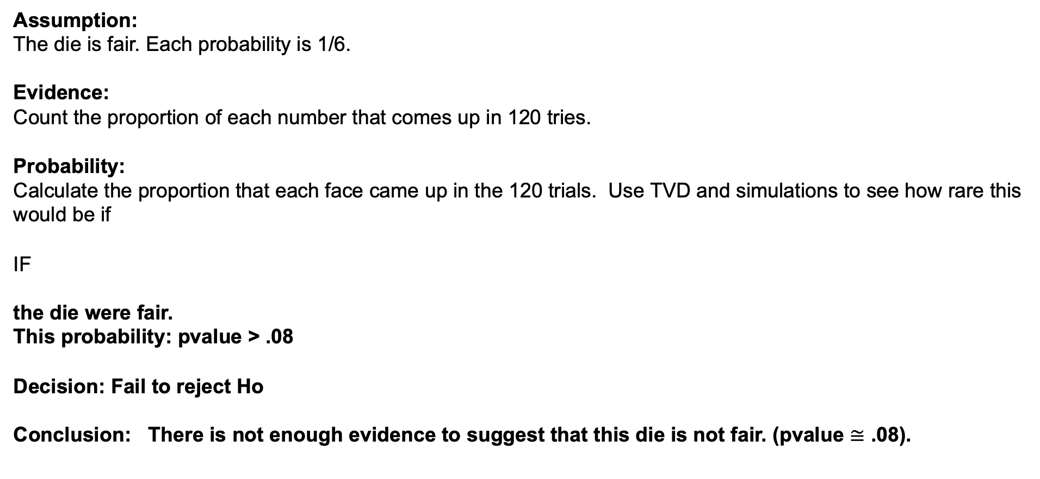
Fair Die?
Assumption:
The die is fair. Each probability is 1/6.
Evidence:
Count the proportion of each number that comes up in 120 tries.
Probability:
Calculate the proportion that each face came up in the 120 trials. Use TVD and simulations to see how rare this would be if
IF
the die were fair.
This probability: pvalue > .08
Decision: Fail to reject Ho
Conclusion: There is not enough evidence to suggest that this die is not fair. (pvalue $≅$ .08).
$$H_{0: }The die is fair$$
$$H_{A: }The die is not fair$$

Slide 8
Break Out!
Conduct a Permutation test to test if the mean creativity score of those offered intrinsic motivation is different from that of those offered extrinsic motivation.
Be thorough in your analysis and conclusion. ☺

Slide 9

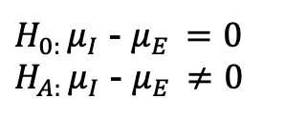
Creativity Study
$H_{0: }μ_{I}$ - $μ_{E }=0$
$H_{A: }μ_{I}$ - $μ_{E }≠0$
Assumption:
The intrinsic / extrinsic treatment has no effect on creativity.
(The mean creativity score of the intrinsic group is equal to the mean score of the extrinsic group.)
Evidence:
The difference in the mean from the sample that received the intrinsic motivation was 4.14 points higher than the mean from the sample that received the extrinsic motivation.
Probability:
${\overline{X}}_{I}−{\overline{X}}_{E}$=4.1442

Slide 10
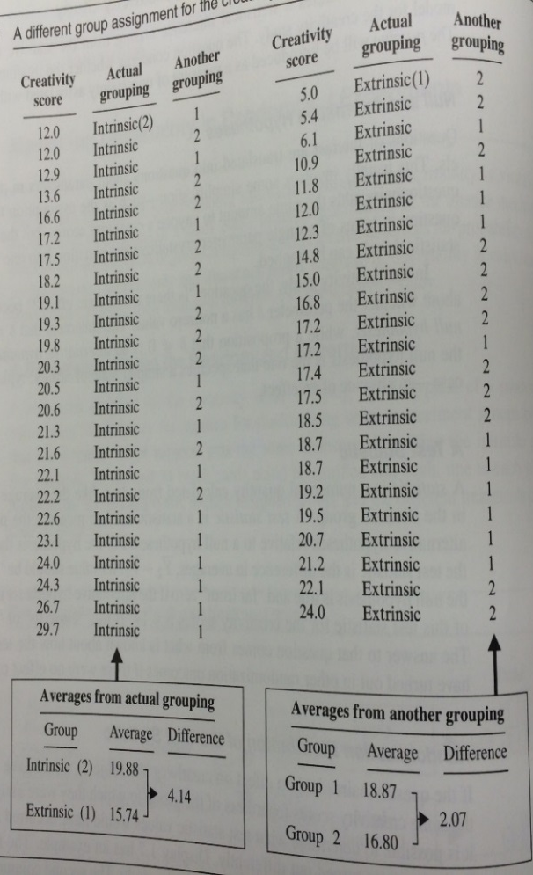
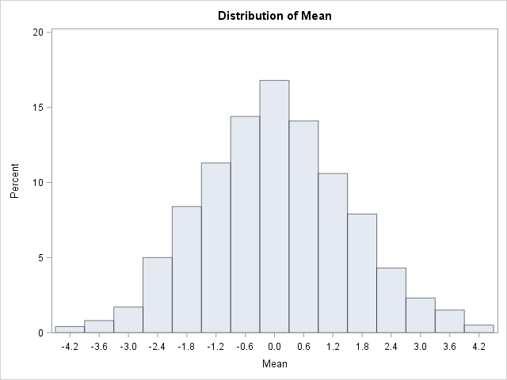

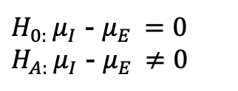
Creativity Study: Pvalue
$H_{0: }μ_{I}$ - $μ_{E }=0$
$H_{A: }μ_{I}$ - $μ_{E }≠0$
1000 different groupings (relabelings)*
Number of random regroupings:
1.6 x 10¹³
Half a year with a computer that can perform a million calculations per second!
$${\overline{X}}_{I}−{\overline{X}}_{E}$$
*Everyone has the same score with each grouping. What group each person is artificially put in changes with each regrouping. If the treatments had the same effect, then each participant would have the same score regardless of grouping.

Slide 11
Creativity Study
(go to SAS code)
The TTEST Procedure
Variable: score
treatment | Method | Mean | 95% CL Mean |  | Std Dev | 95% CL Std Dev
0 |  | 19.8833 | 18.0087 | 21.7580 | 4.4395 | 3.4504 | 6.2276
1 |  | 15.7391 | 13.4677 | 18.0105 | 5.2526 | 4.0623 | 7.4343
Diff (1-2) | Pooled | 4.1442 | 1.2914 | 6.9970 | 4.8541 | 4.0261 | 6.1138
Diff (1-2) | Satterthwaite | 4.1442 | 1.2776 | 7.0108

Slide 12
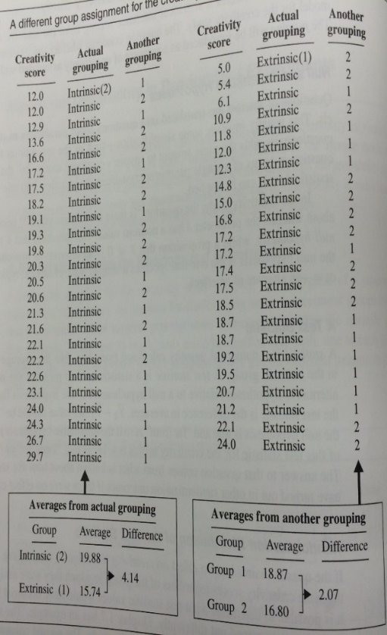


Creativity Study
Assumption:
The intrinsic / extrinsic treatment has no effect on creativity.
(The mean creativity score of the intrinsic group is equal to the mean score of the extrinsic group.)
Evidence:
The difference in the mean from the sample that received the intrinsic motivation was 4.14 points higher than the mean from the sample that received the extrinsic motivation.
Probability:
The estimated probability that a difference 4.14 or larger in sample mean scores would occur if there was not effect is .008.
$H_{0: }μ_{I}$ - $μ_{E }=0$
$H_{A: }μ_{I}$ - $μ_{E }≠0$
-4.14
4.14
1000 different groupings (relabelings)
$${\overline{X}}_{I}−{\overline{X}}_{E}$$
P-value = 8/1000
= 0.008
Obs | Variable | Class | Method | Variances | Mean | LowerCLMean | UpperCLMean | StdDev | LowerCLStdDev | UpperCLStdDev | UMPULowerCLStdDev | UMPUUpperCLStdDev
1 | COL139 | Diff (1-2) | Pooled | Equal | 4.4678 | 1.6594 | 7.2762 | 4.7786 | 3.9635 | 6.0187 | 3.9360 | 5.9708
2 | COL170 | Diff (1-2) | Pooled | Equal | -4.3192 | -7.1485 | -1.4899 | 4.8141 | 3.9930 | 6.0634 | 3.9653 | 6.0152
3 | COL279 | Diff (1-2) | Pooled | Equal | -4.5576 | -7.3530 | -1.7623 | 4.7564 | 3.9451 | 5.9908 | 3.9178 | 5.9430
4 | COL360 | Diff (1-2) | Pooled | Equal | -4.8897 | -7.6340 | -2.1454 | 4.6695 | 3.8731 | 5.8814 | 3.8462 | 5.8345
5 | COL537 | Diff (1-2) | Pooled | Equal | 4.3826 | 1.5621 | 7.2031 | 4.7991 | 3.9806 | 6.0446 | 3.9530 | 5.9964
6 | COL551 | Diff (1-2) | Pooled | Equal | -5.0514 | -7.7692 | -2.3337 | 4.6243 | 3.8356 | 5.8245 | 3.8090 | 5.7781
7 | COL604 | Diff (1-2) | Pooled | Equal | -4.7109 | -7.4832 | -1.9385 | 4.7172 | 3.9127 | 5.9415 | 3.8855 | 5.8942
8 | COL664 | Diff (1-2) | Pooled | Equal | 4.6636 | 1.8840 | 7.4431 | 4.7295 | 3.9228 | 5.9569 | 3.8956 | 5.9095
Conclusion: There is strong evidence to suggest that the mean score of those who receive intrinsic motivation is not equal to (greater than) those who receive the extrinsic motivation (p-value = .008). Since this was a randomized experiment, we can conclude that the intrinsic motivation caused this increase. In addition, since these were volunteers, this inference can only be assumed to apply to these 47 subjects, although the findings are very intriguing.

Slide 13
Creativity Study
$H_{0: }μ_{I}$ - $μ_{E }=0$
$H_{A: }μ_{I}$ - $μ_{E }≠0$
Assumption:
The intrinsic / extrinsic treatment has no effect on creativity.
(The mean creativity score of the intrinsic group is equal to the mean score of the extrinsic group.)
Evidence:
The difference in the mean from the sample that received the intrinsic motivation was 4.14 points higher than the mean from the sample that received the extrinsic motivation.
Probability:
The probability is very small (approx .5%) that we would observe something as rare as 4.14 if the true are equal.
Decision:
Reject Ho: the means are equal
Conclusion:
There is strong evidence to suggest that the means are different (pvalue = .008).
${\overline{X}}_{I}−{\overline{X}}_{E}$=4.1442

